Slide 1


ECEN 404
Bi-Weekly Update 3
Matrix 1 / “Scooter Juice”
Connor Cottongame
John Dusterhoff
Blake Hallam
Oscar Rubio
TA: Sabyasachi Gupta
Sponsor: Prof Prasad Enjeti

Slide 2

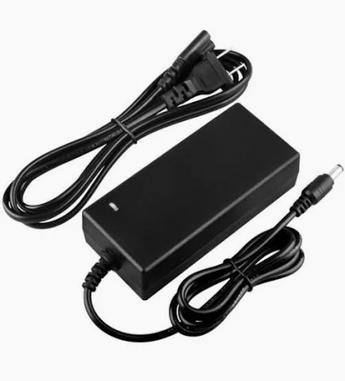

Project Summary
Problem statement:
Current electric scooter chargers are bulky and inconvenient to use, requiring large, external rectifiers to charge their batteries, much like a laptop charger.
Our Solution:
This team will design and build an IOBC (Integrated On-Board Charger), allowing the scooter to be charged directly from an AC power source.
This charger will use the existing inverter components in the scooter as a rectifier in order to charge the battery.

Slide 3
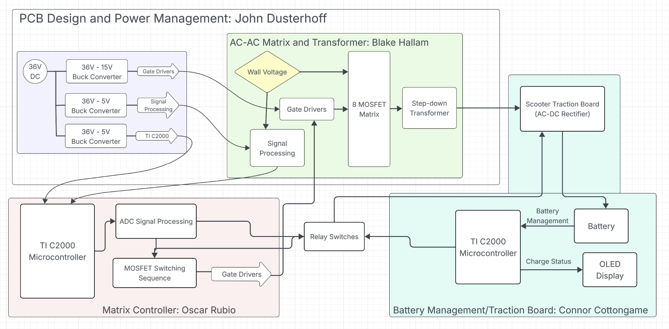
System Overview
Notes:
Cloud server and database

Slide 4
Project Timeline
Subsystem Designs and Updated and necessary testing (completed by 9/14) | Final subsystem testing and start integration (completed by 9/28) | Integration of MCU, signal processing and power stages (complete by 10/1) | Final Integration (to complete by 10/22) | Full System Testing (to complete by 11/5) | Full System Validation (to complete by 11/12) | Demo and Report (to complete by 12/5)

Slide 5
Signals & Power Conditioning
Blake Hallam
Accomplishments since Update #2 10 hrs of effort | Ongoing progress/problems and plans until the next presentation
Completed testing for the gate drivers. Ordered all components necessary for new PCB. Started integration with Oscars Sub-system. | Further integration with Oscars sub-system. If all components and new PCB arrive, complete assembly of the board. Testing the MOSFET’s and their 15V supplies.

Slide 6
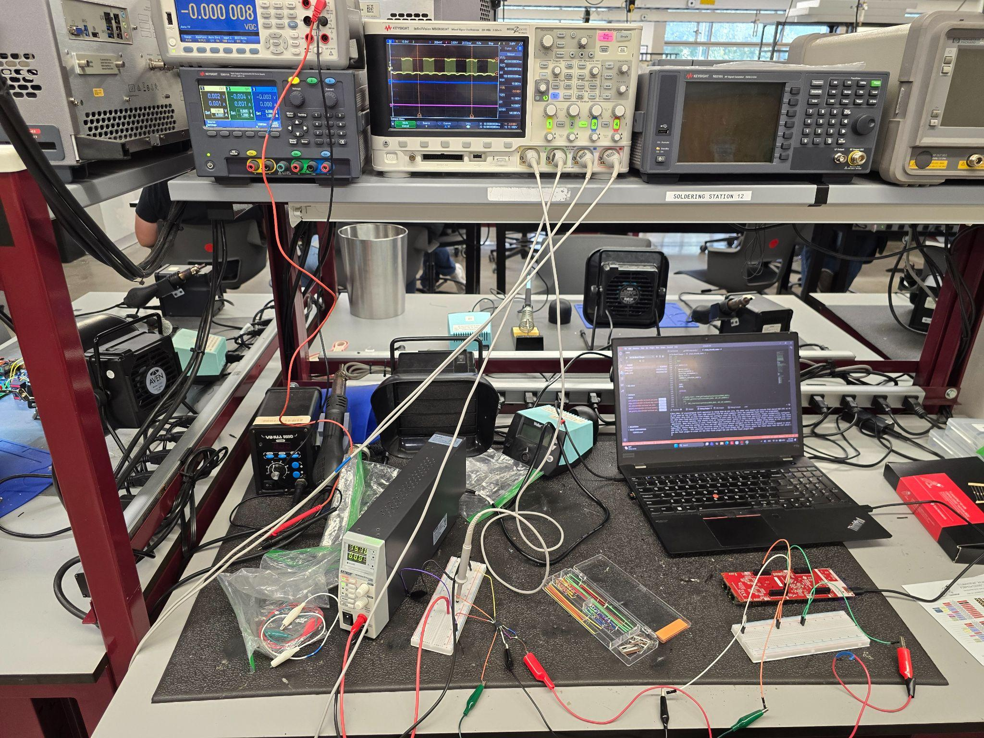
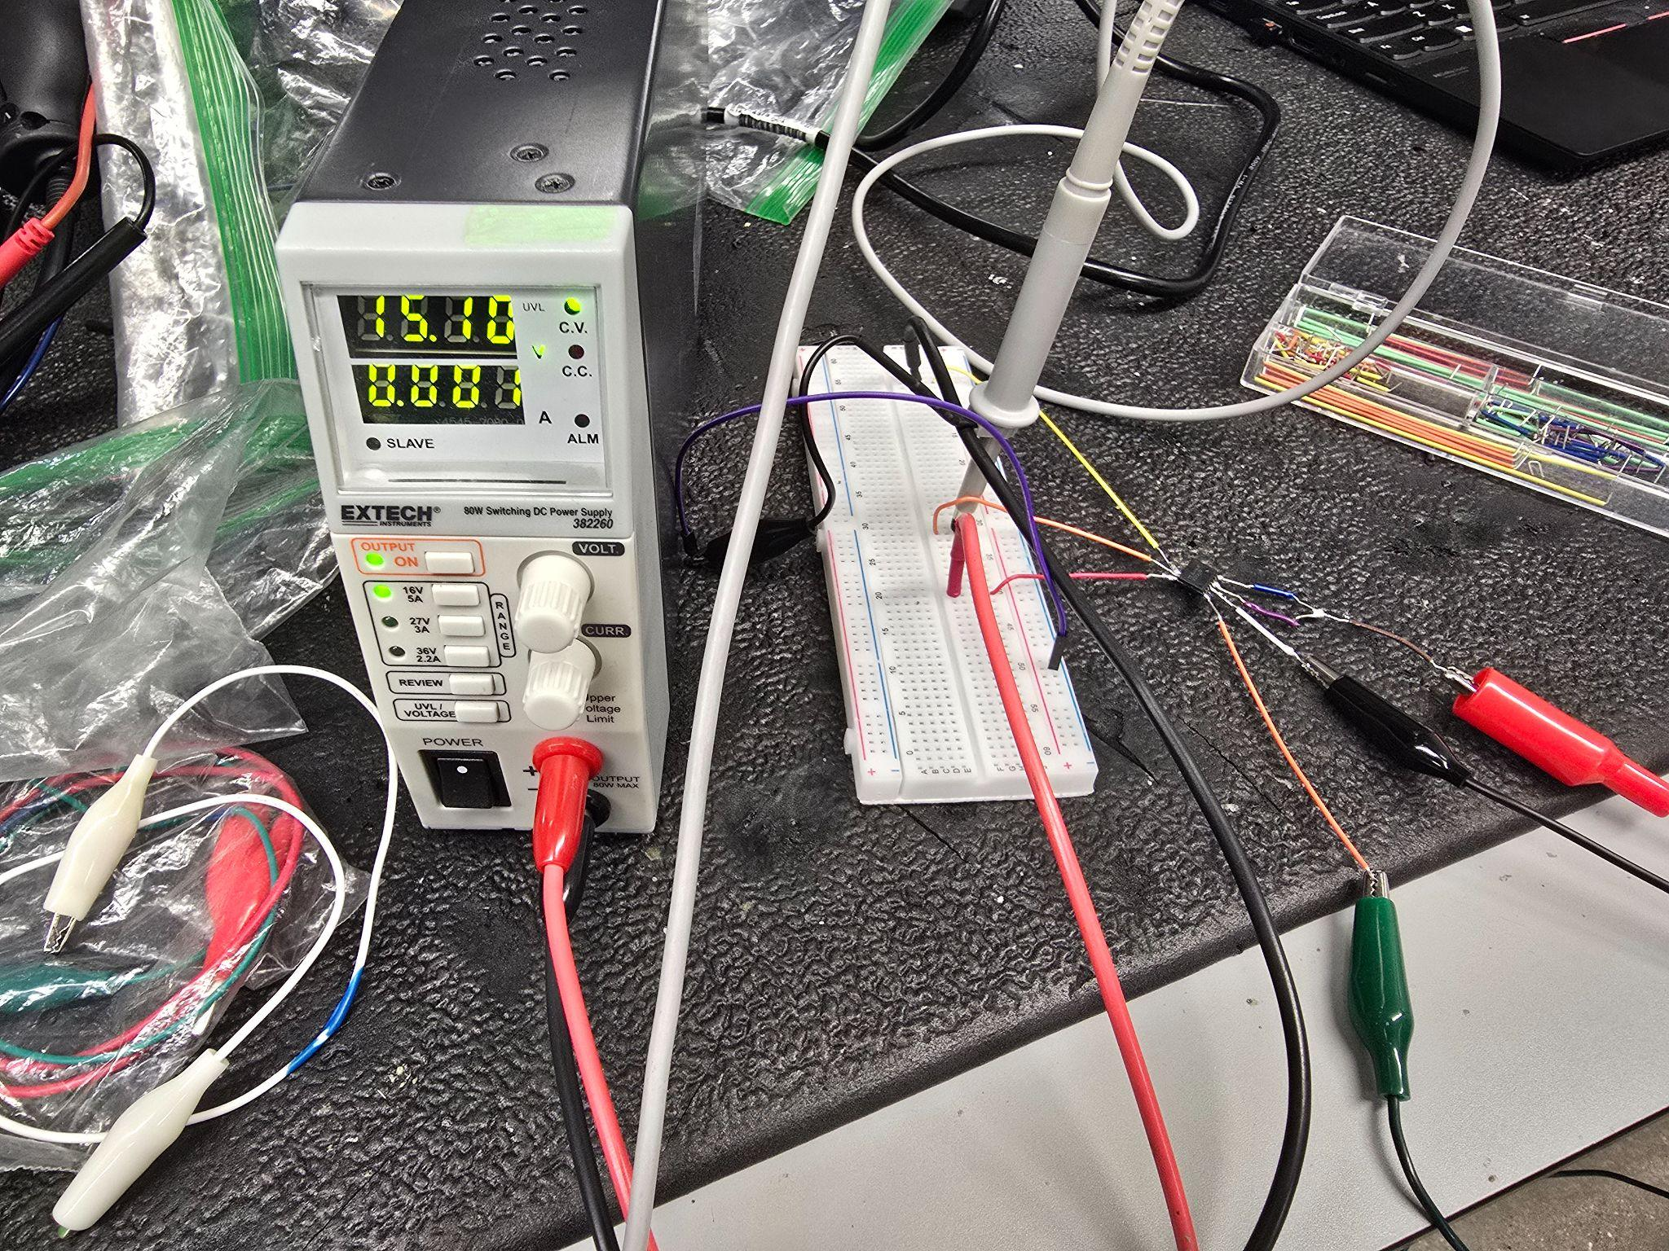
Signals & Power Conditioning
Blake Hallam

Slide 7
Matrix Control and Enclosure
Oscar Rubio
Accomplishments since Update #2 16 hrs of effort | Ongoing progress/problems and plans until the next presentation
Validated ADC measurements/calculations Completed integration testing on Matrix Control and Gate Drivers in Blake’s Subsystem | Integrate/Test the matrix control and gate drivers with Mosfets Finish designing scooter enclosure once V2 PCBs arrive and can get measurements Stretch Goal: Once PCB has arrived/soldered integrate and test ADC with signals from Isolation/Differential Amplifier

Slide 8
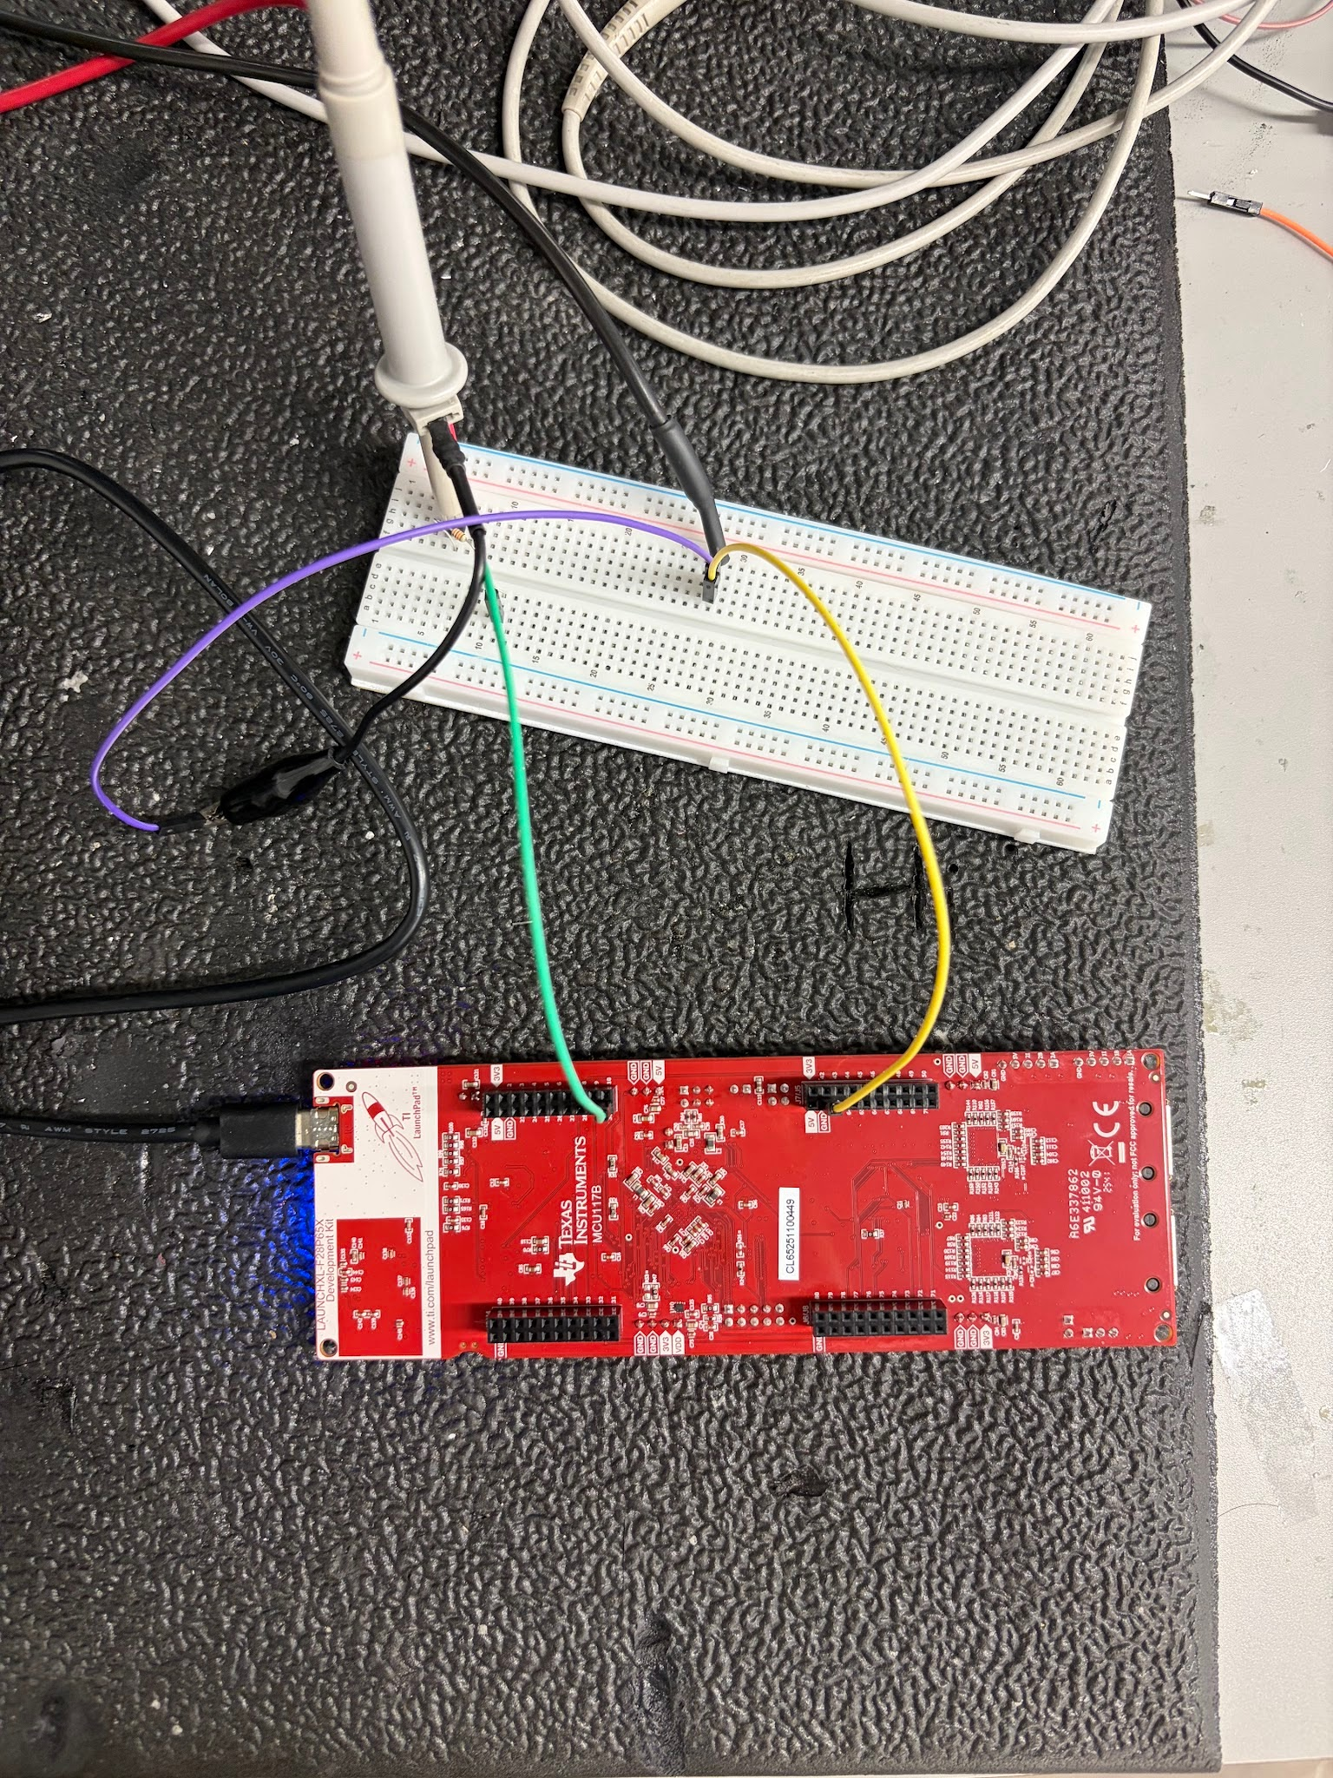
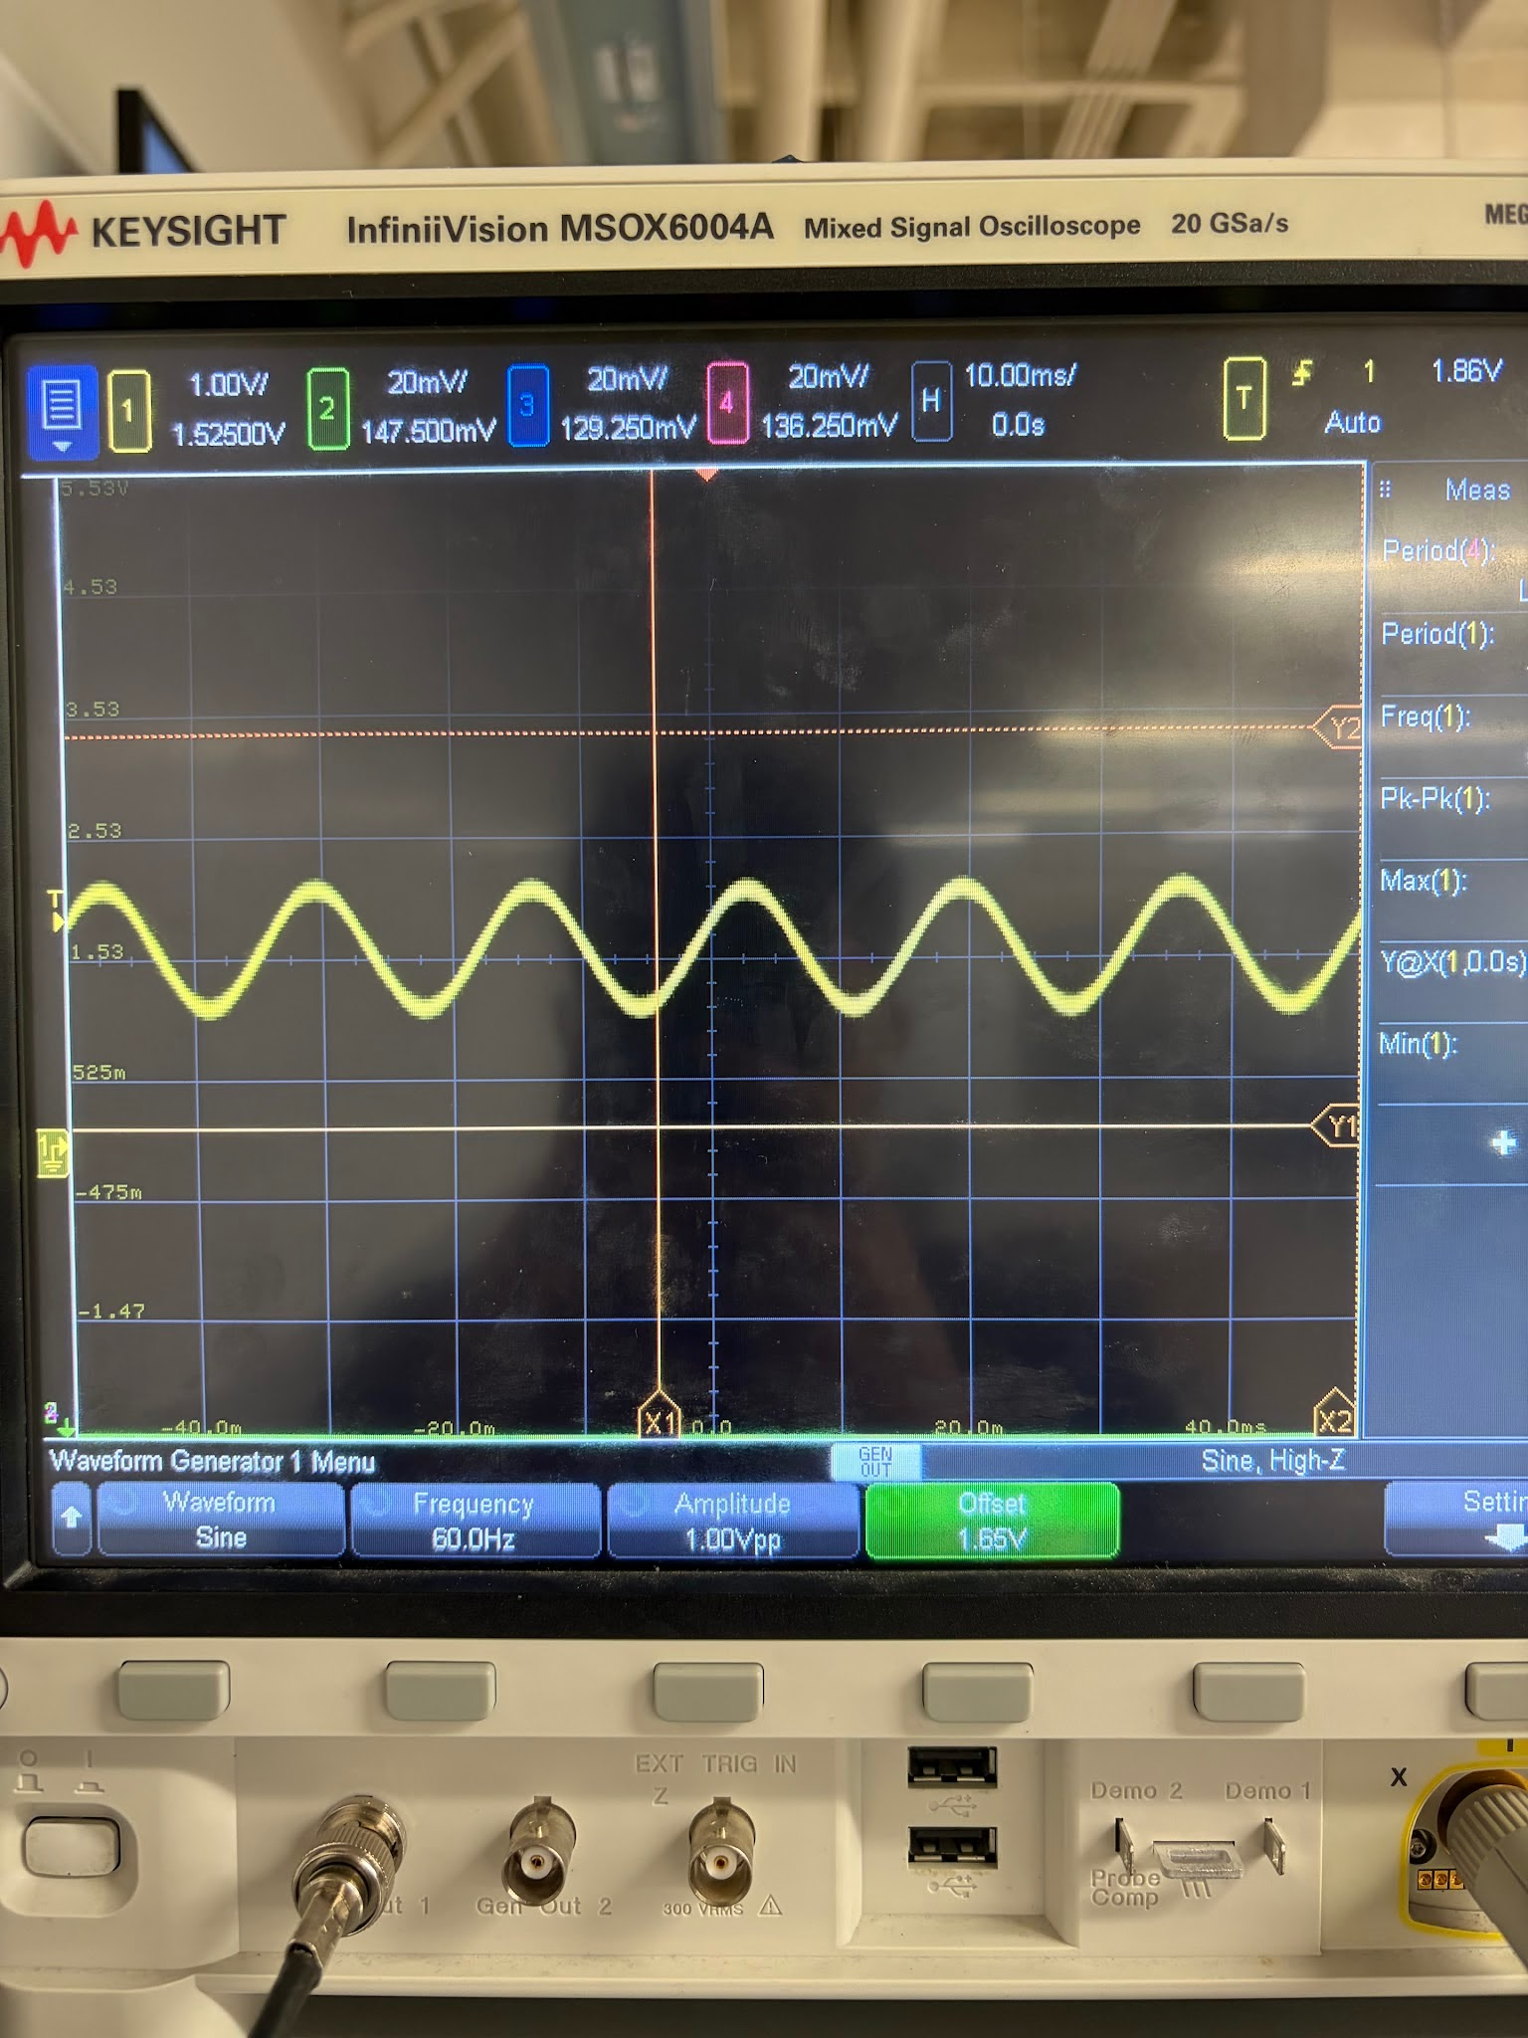
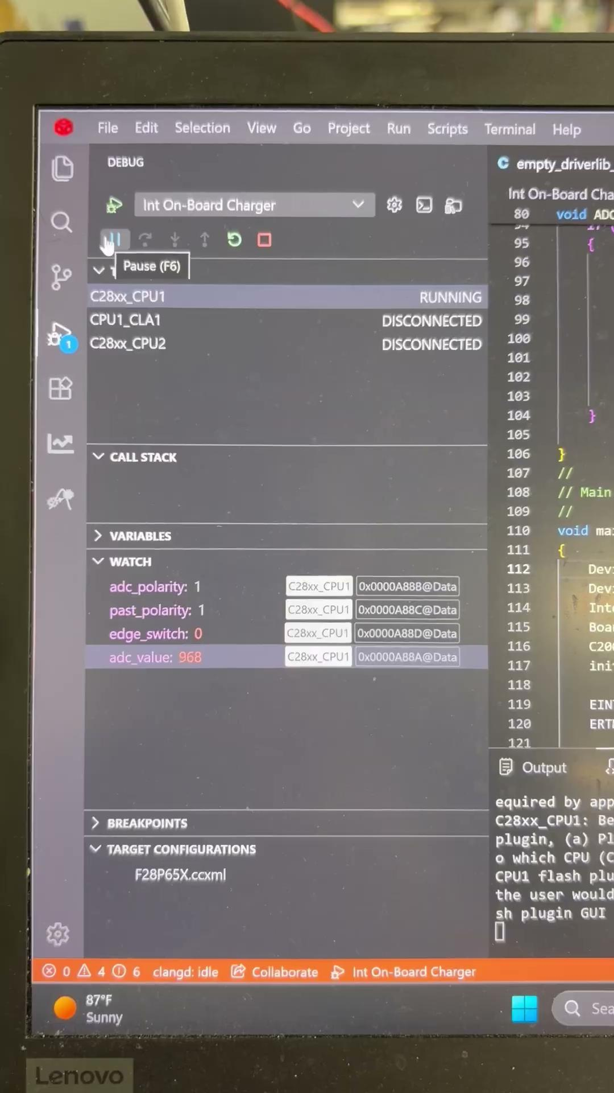
Matrix Control and Enclosure
Oscar Rubio

Slide 9
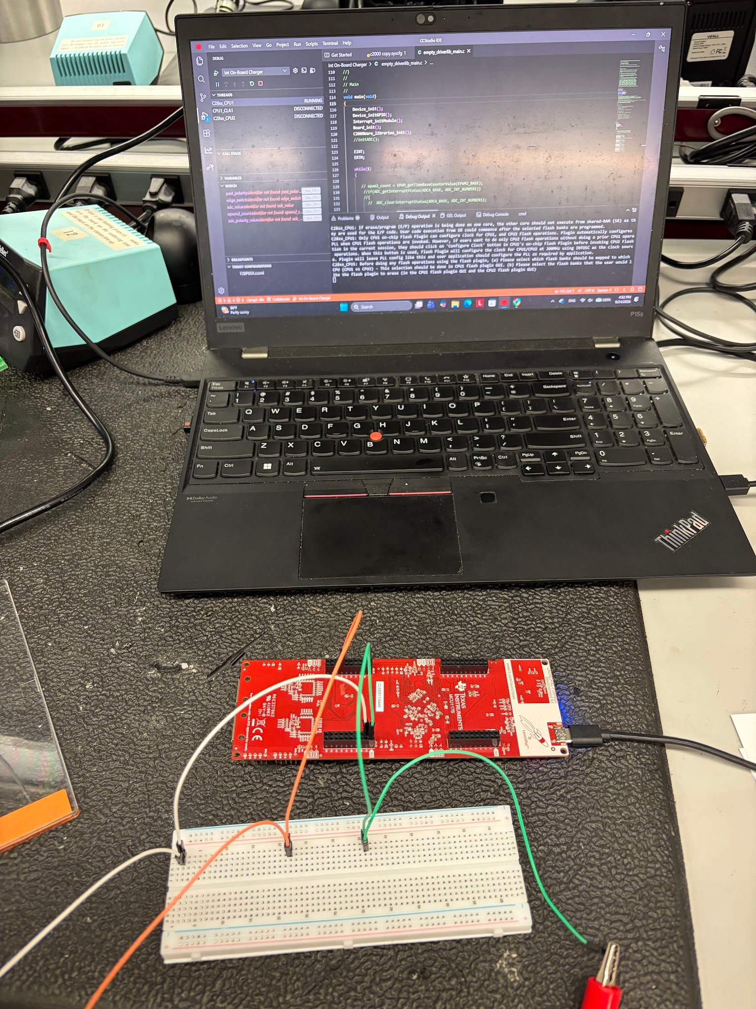
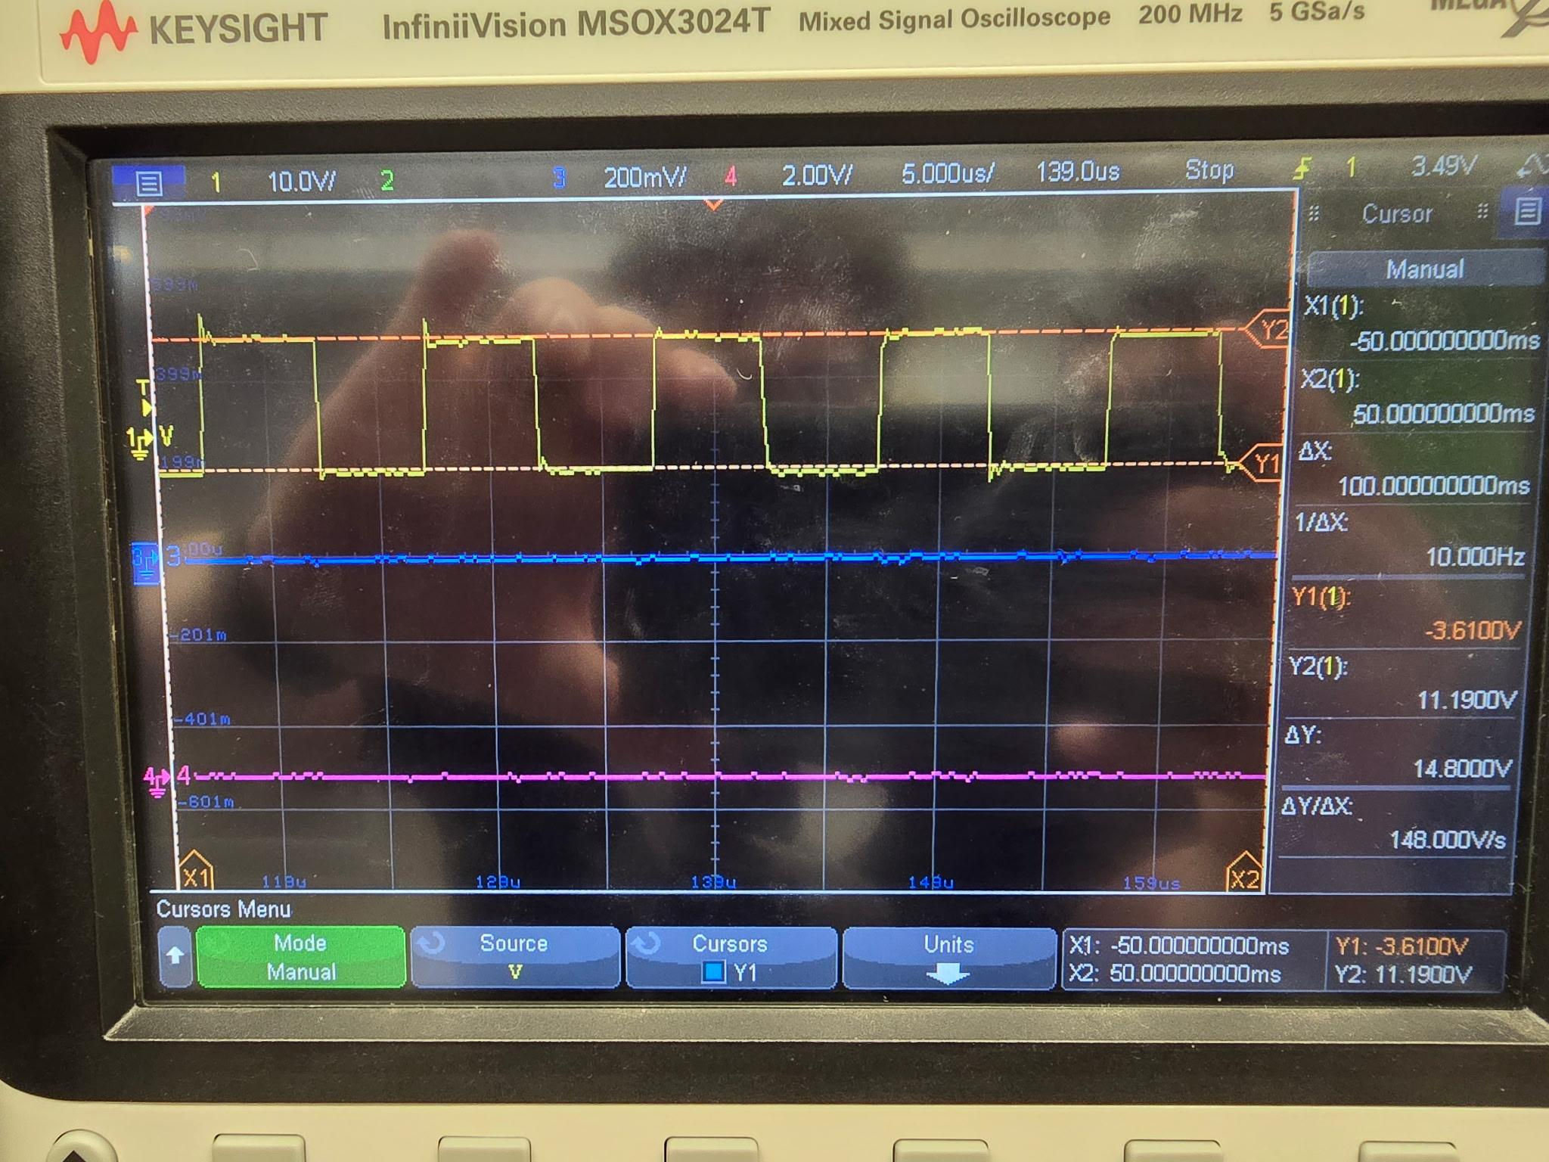
Matrix Control and Enclosure
Oscar Rubio

Slide 10
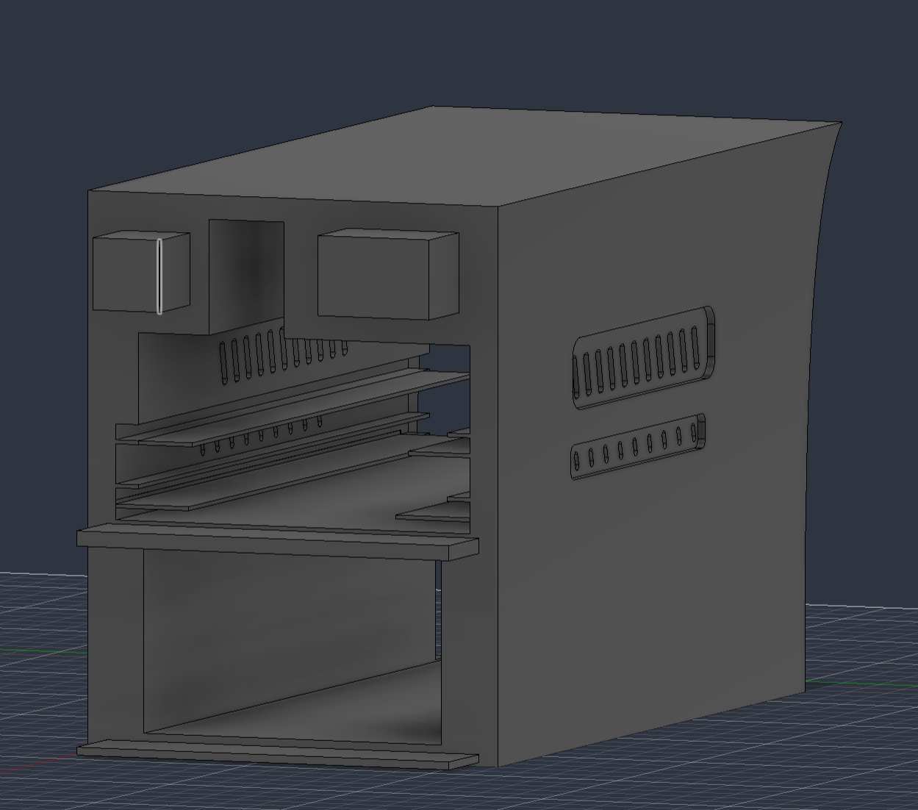
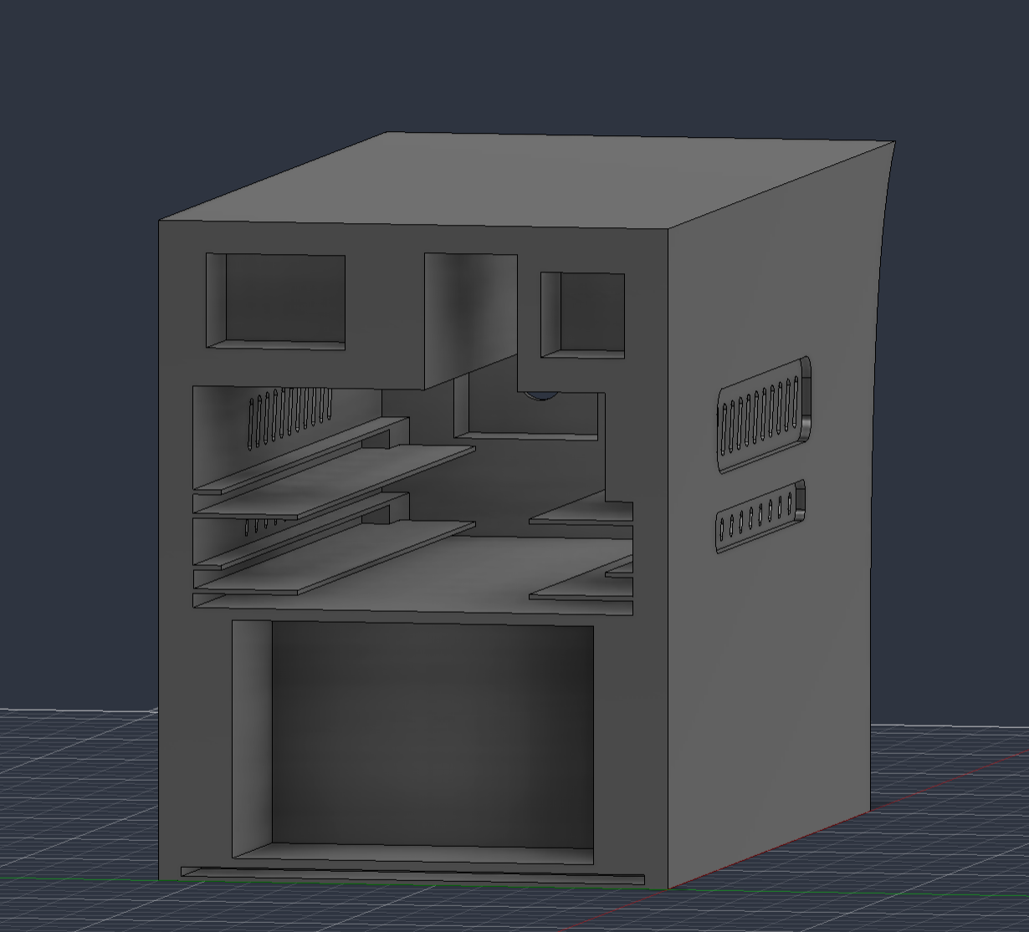
Matrix Control and Enclosure
Oscar Rubio

Slide 11
PCB Design
John Dusterhoff
Accomplishments since Update #2 14 hrs of effort | Ongoing progress/problems and plans until the next presentation
Primary PCB Ordered Primary PCB Delivered BOM Ordered Battery Testing started (discharge speed, voltage at different charge levels) | PCB Version 2 testing and integration Primary side PCB integrated with secondary side PCB Finish battery testing

Slide 12
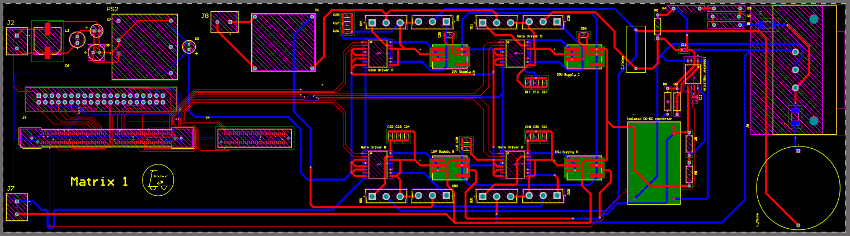
PCB Design
John Dusterhoff

Slide 13
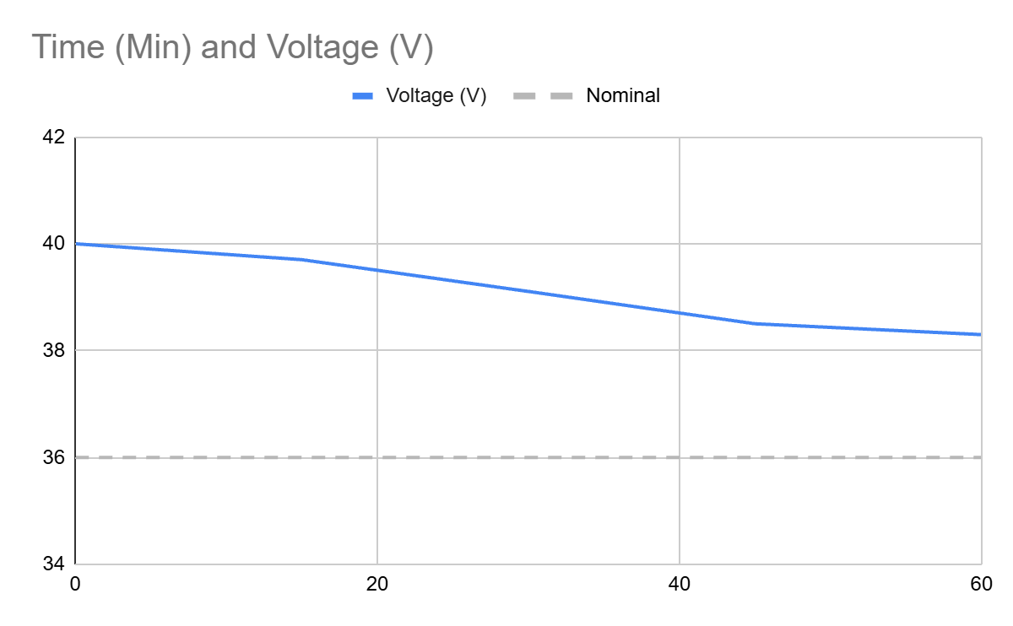
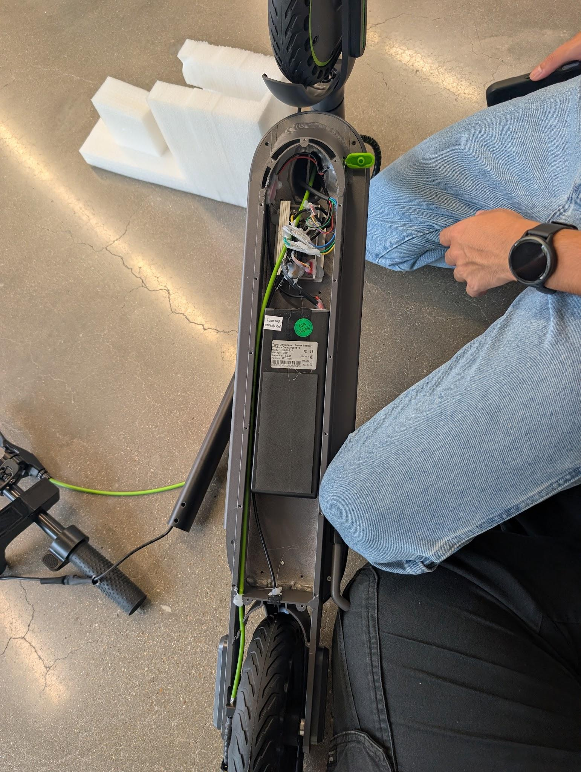
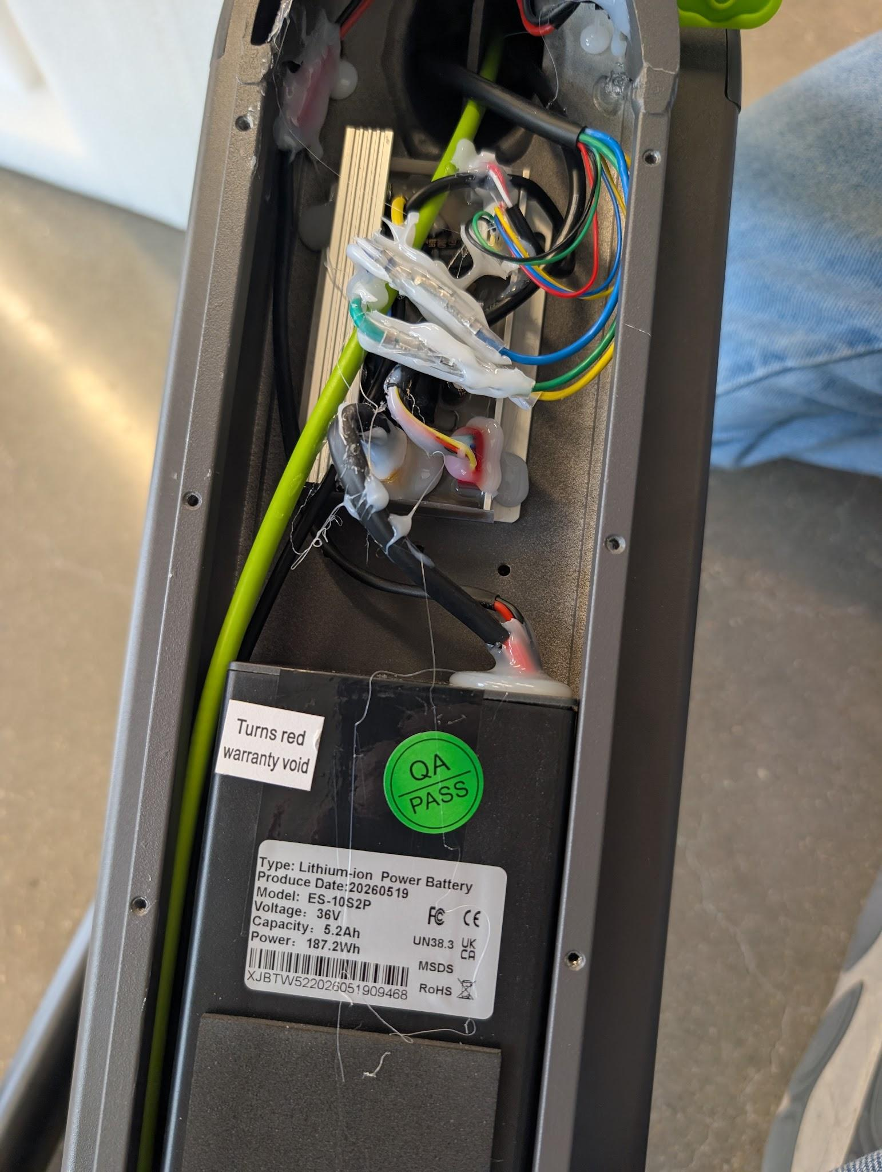
PCB Design
John Dusterhoff

Slide 14
Charging Control Software and DAB Secondary Side
Connor Cottongame
Accomplishments since Update #2 10 hrs of effort | Ongoing progress/problems and plans until the next presentation
PCB layout and routing completed, PCB ordered, still waiting on delivery (JLC delay) 100x100mm Improvements over V1: relays for mode switching, motor phase and DAB circulating current sensing, local voltage converters | PCB assembly Test motor control w/ actual scooter motor (doesn’t rely on other subsystems) Test power conversion before full integration by using a 2nd PCB to act as a primary active bridge, testing at fixed operating point

Slide 15
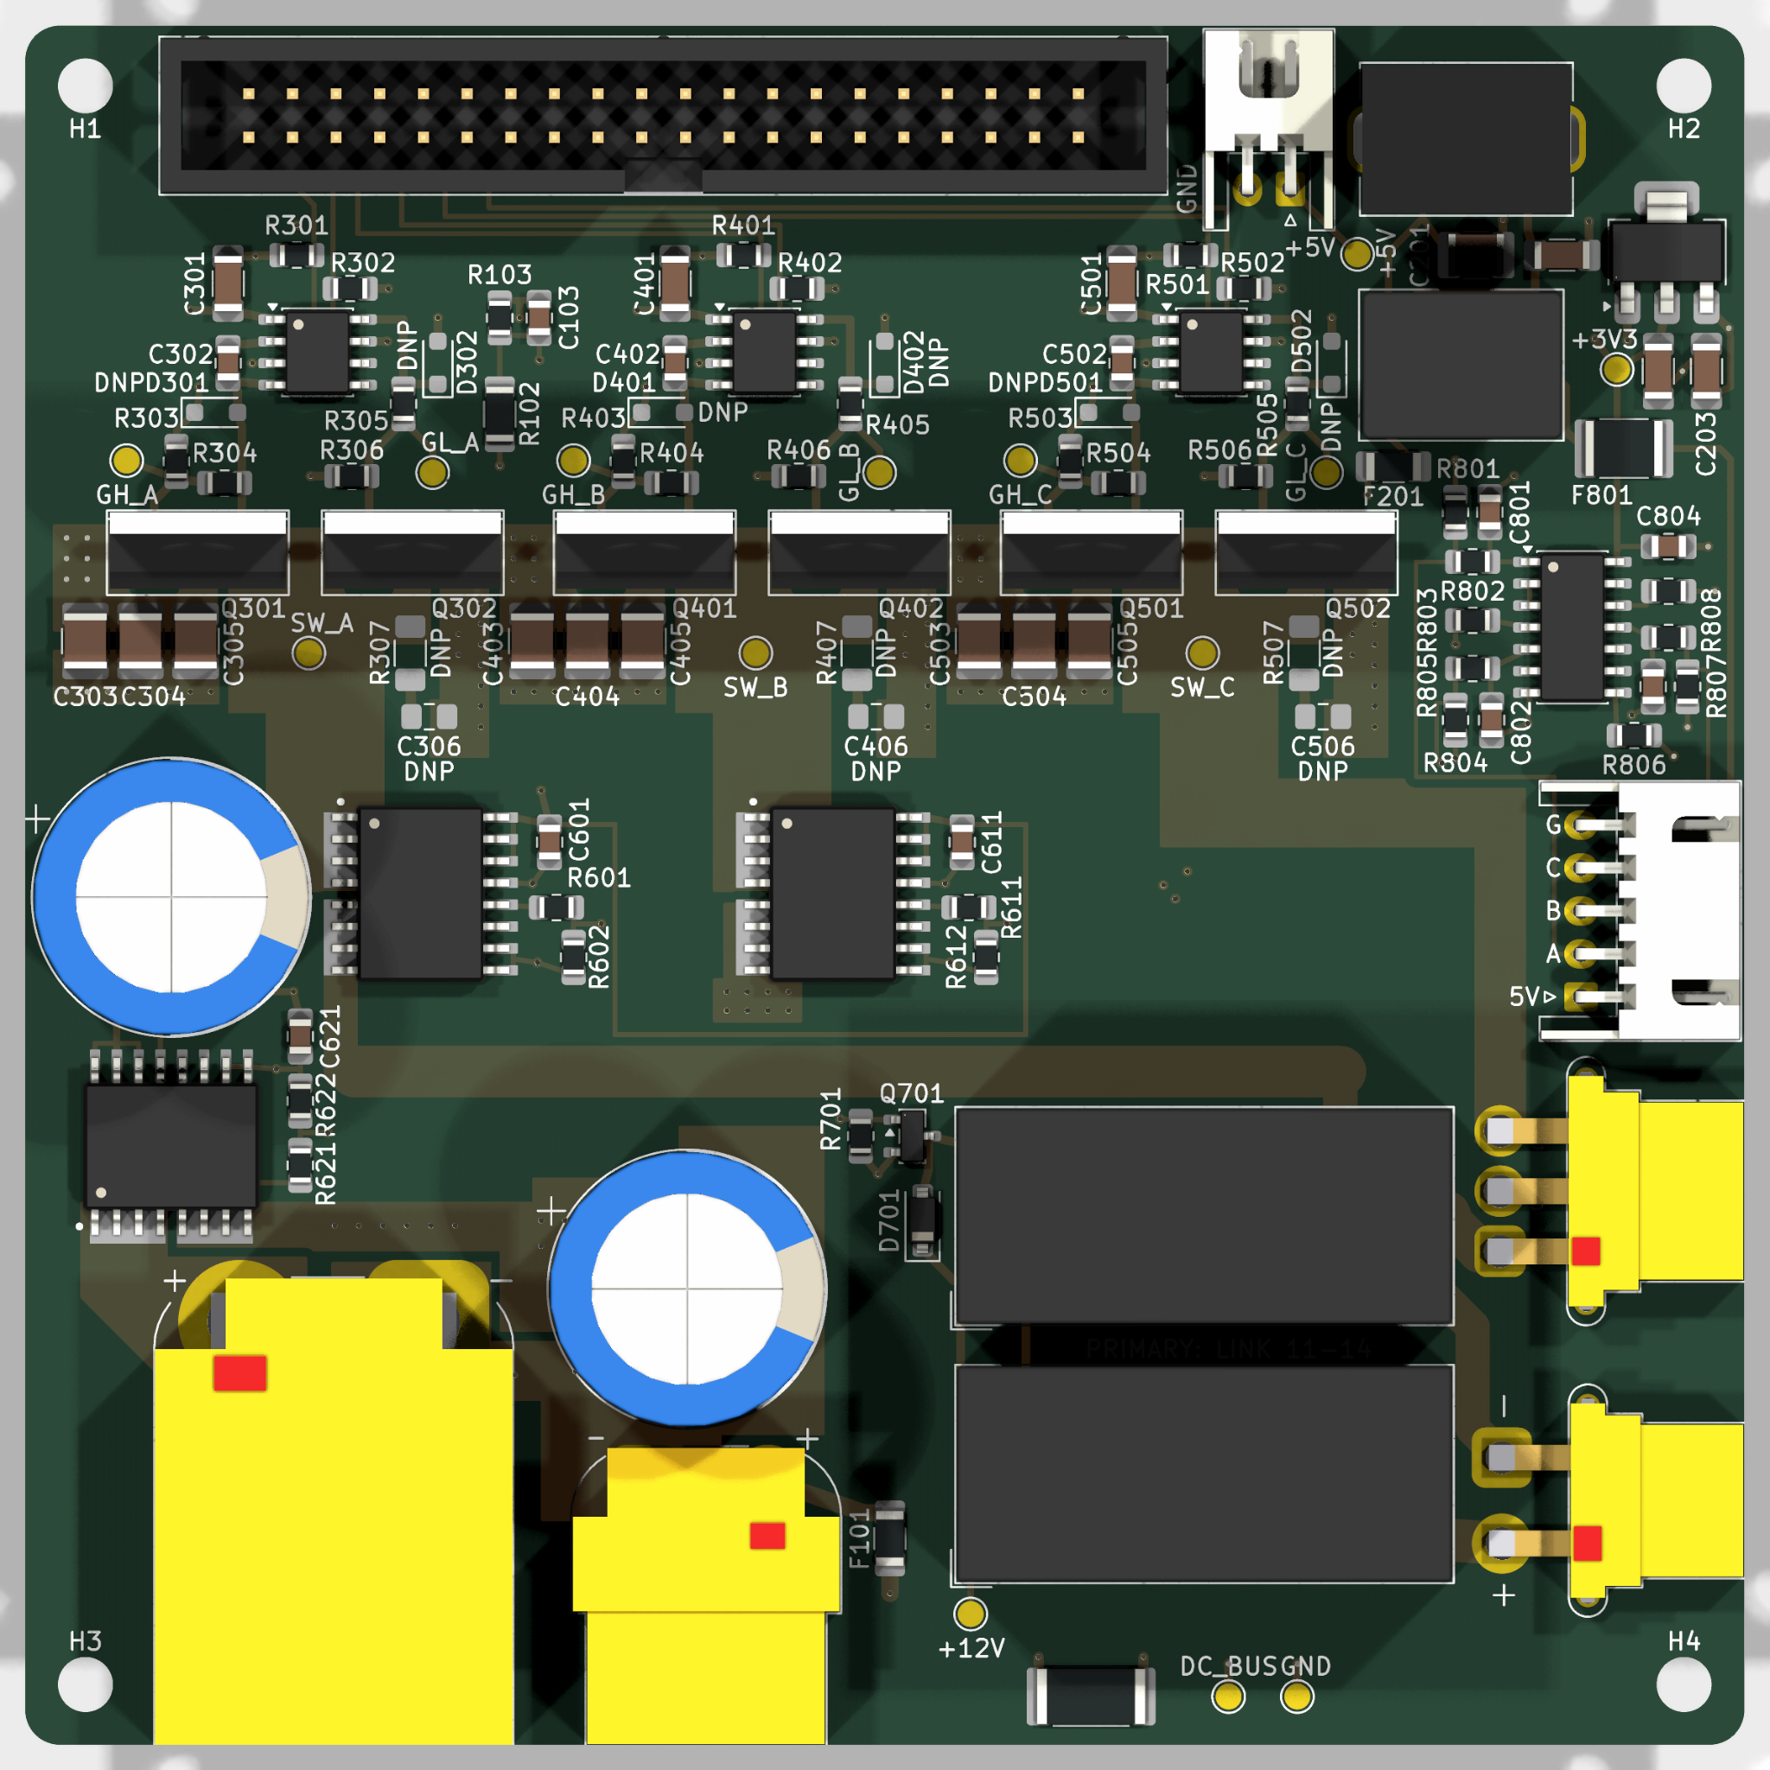
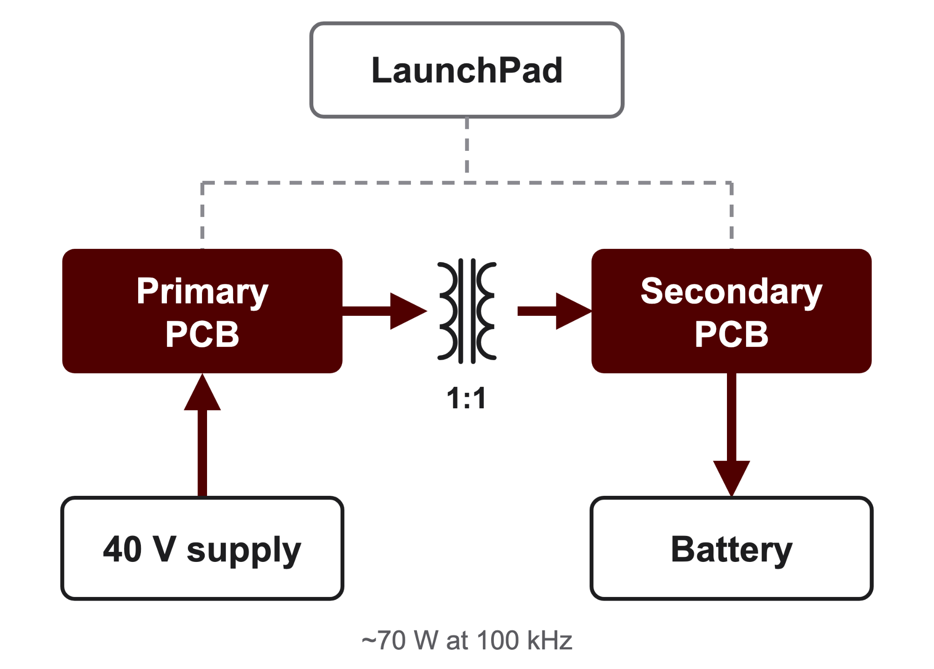
Charging Control Software and DAB Secondary Side
Connor Cottongame

Slide 16
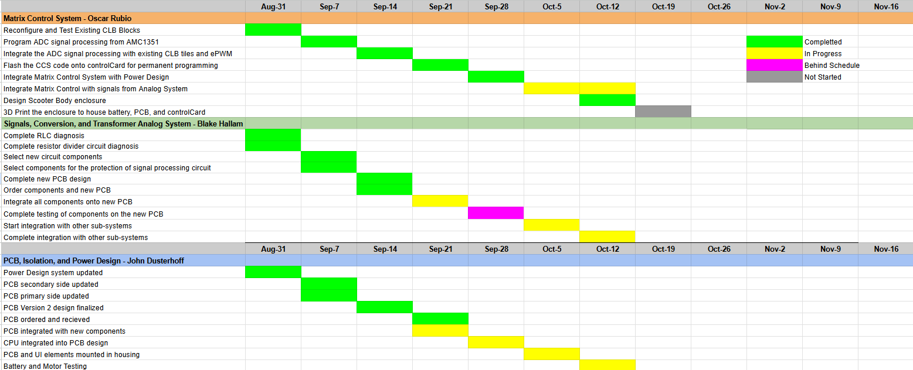
Execution Plan

Slide 17
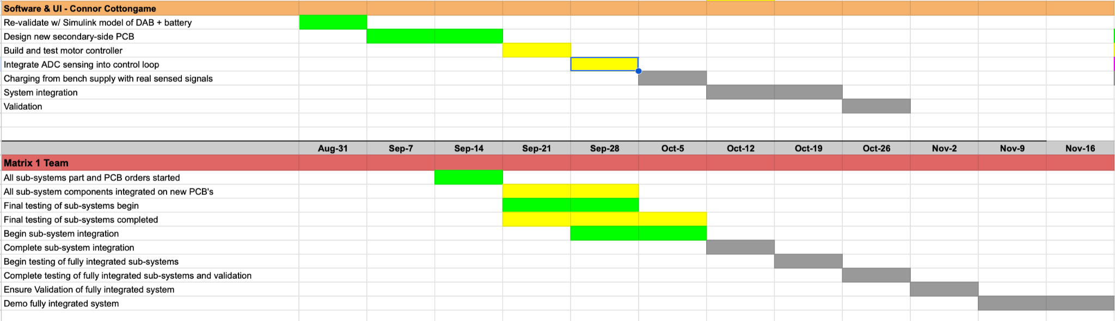
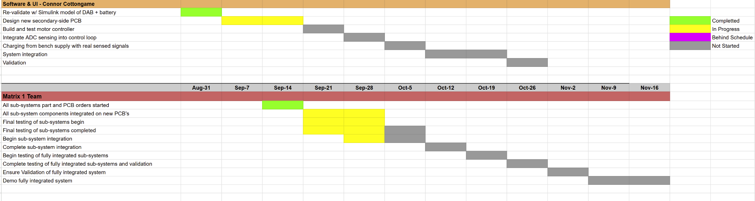
Execution Plan

Slide 18
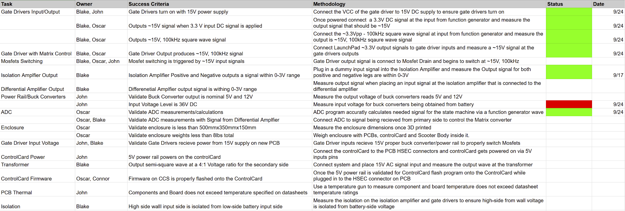
Validation Plan

Slide 19
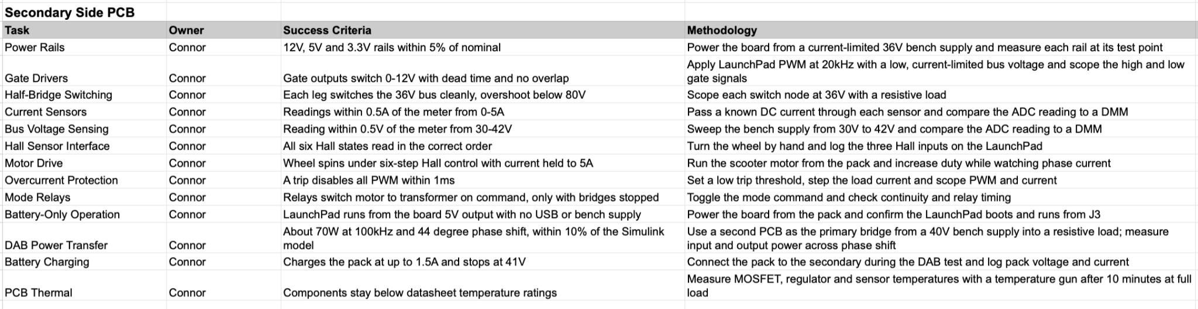
Validation Plan

Slide 20
Thank You For Your Time and Attention
Any Questions?
Matrix 1 / “Scooter Juice”
Connor Cottongame
John Dusterhoff
Blake Hallam
Oscar Rubio
TA: Sabyasachi Gupta
Sponsor: Prof Prasad Enjeti

